Slide 1
Version Control with GitHub Desktop
DR KIM MARTIN
29 AUG 2022
LinkedIn: kcmartin

Slide 2
Version Control with GitHub Desktop © Copyright 2022, Dr Kim Martin
This work was inspired by ‘GitHub without the command line’ © Copyright 2020, CodeRefinery contributors.
https://coderefinery.github.io/github-without-command-line/
These instructional materials are made available under the Creative Commons Attribution license. The following is a human-readable summary of (and not a substitute for) the full legal text of the CC BY 4.0 license.
You are free:
to Share—copy and redistribute the material in any medium or format
to Adapt—remix, transform, and build upon the material
for any purpose, even commercially.
The licensor cannot revoke these freedoms as long as you follow the license terms.
Under the following terms:
Attribution—You must give appropriate credit (mentioning that your work is derived from work that is Copyright © Kim Martin and, where practical, linking to the source url), provide a link to the license, and indicate if changes were made. You may do so in any reasonable manner, but not in any way that suggests the licensor endorses you or your use.
No additional restrictions—You may not apply legal terms or technological measures that legally restrict others from doing anything the license permits. With the understanding that:
Notices:
You do not have to comply with the license for elements of the material in the public domain or where your use is permitted by an applicable exception or limitation.
No warranties are given. The license may not give you all of the permissions necessary for your intended use. For example, other rights such as publicity, privacy, or moral rights may limit how you use the material.

Slide 3
Preparation:
Create a GitHub account:
https://www.github.com
Download and install GitHub Desktop:
https://desktop.github.com/
Download and install both R and RStudio:
https://posit.co/download/rstudio-desktop/
Download the ‘Exercise files’:
https://github.com/RSE-at-SUN/GitHub-Desktop-workshop-2022

Slide 4

… we are ALL here to help each other!

Slide 5
Why Git?
Powerful
“Version control on steroids”
Can be used for large projects involving many people - e.g. Linux
Popular
Used by many (most?) professional coders
Used extensively in Open Source / Open Science work
Practical
Help you do your work efficiently, and work efficiently with others
Good skill for the CV!

Slide 6

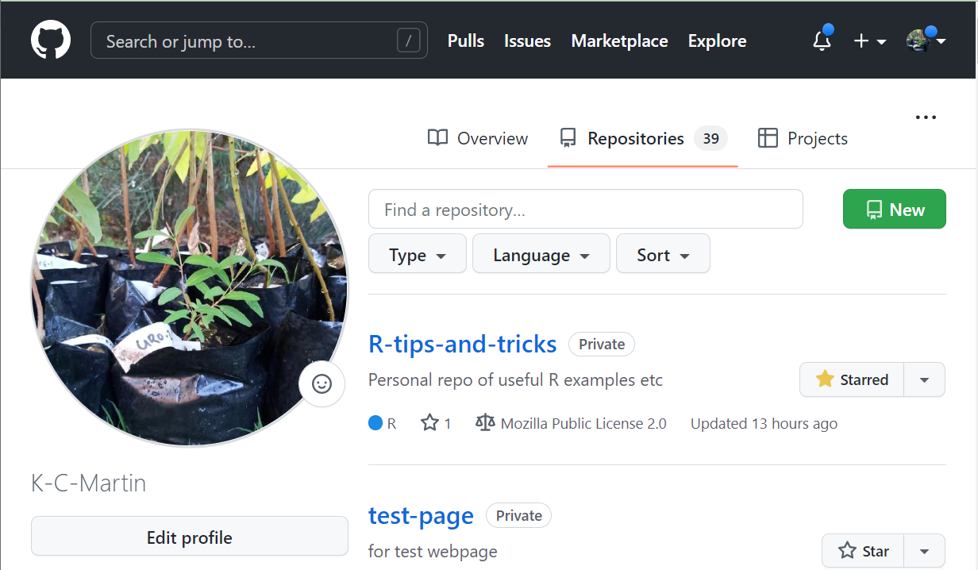
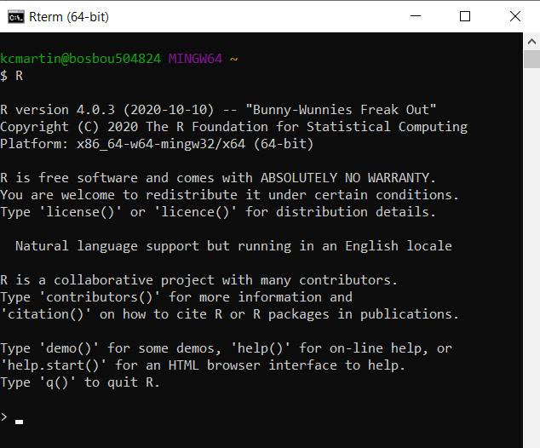

Git
GitHub
A version control software… controlled by command-line and some Graphical User Interfaces (GUIs) … e.g. ‘GitHub Desktop’
An online (cloud) host to backup and share git repositories (repos)

Slide 7
Basic idea - staging and committing
add
commit
push
Workspace
Staging Area
Local Repo
Remote Repo
(e.g. in GitHub)

Slide 8
Basic idea - staging and committing
add
commit
push
Workspace
Staging Area
Local Repo
Remote Repo
(e.g. in GitHub)

Slide 9
Commit history - ‘snapshot’ of each new commit (with ID)
INSIDE REPO:
#1

Slide 10
Commit history - timeline of version changes (with IDs)
INSIDE REPO:
#1
#2
#3

Slide 11
Commit history - branches (trying out different edits)
INSIDE REPO:
main
#1
#2
#3
#4
test-branch
#5

Slide 12
Commit history - branches can be merged
INSIDE REPO:
main
#1
#2
#3
#4
#6
#5

Slide 13
Commit history - branch names refer to most recent commit
INSIDE REPO:
main
#1
#2
#3
#4
#6
#7
#5

Slide 14
Commit history - HEAD is the current state of the repo
INSIDE REPO:
HEAD
main
#1
#2
#3
#4
#6
#7
#5

Slide 15
Commit history - HEAD moves as you checkout versions
INSIDE REPO:
HEAD
main
#1
#2
#3
#4
#6
#7
#5

Slide 16
Commit history - HEAD moves as you checkout versions
INSIDE REPO:
main
#1
#2
#3
#4
#6
#7
HEAD
#5

Slide 17
Commit history - HEAD moves as you checkout versions
INSIDE REPO:
HEAD
main
#1
#2
#3
#4
#6
#7
#5

Slide 18
Commit history - you can ‘tag’ special versions
INSIDE REPO:
main
#1
#2
#3
#4
#6
#7
crazy-experiment
#5

Slide 19
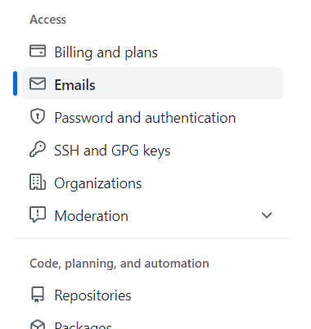
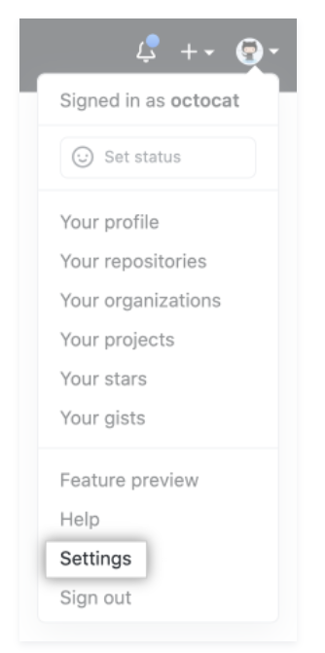
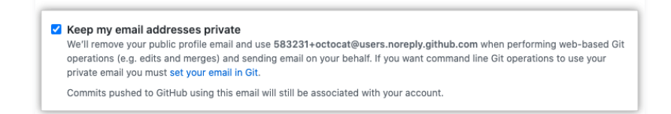
GO TO GITHUB.COM AND SIGN-IN:
In top-right, select avatar image and choose ‘Settings’ from dropdown
On left side, select ‘Emails’
Scroll down to make sure the ‘Keep my email addresses private’ option is checked
Copy the email address that looks something like:
223423+username@users.noreply.github.com
… paste it somewhere safe - you might need it soon
https://docs.github.com/en/account-and-profile/setting-up-and-managing-your-github-user-account/managing-email-preferences/setting-your-commit-email-address

Slide 20
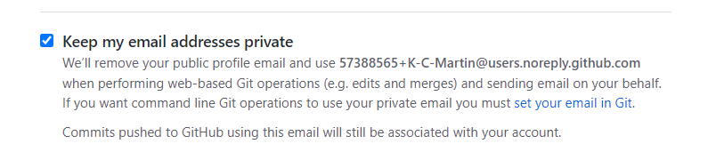
GitHub: [Avatar] > Settings > Emails (copy email address)

Slide 21
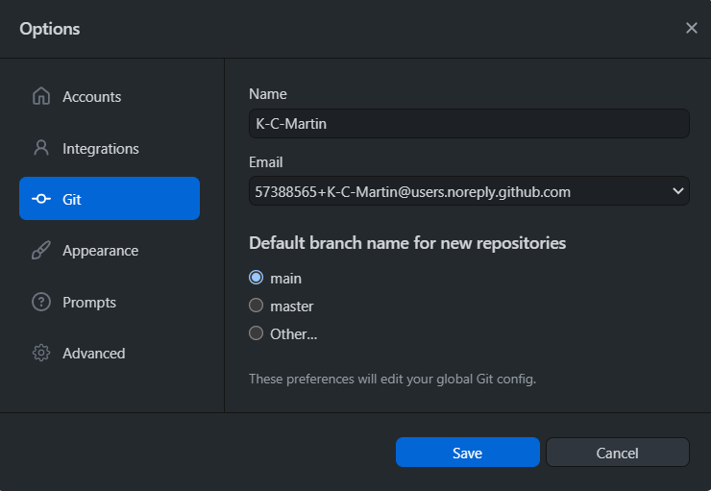
GitHub Desktop: File > Options > Git (‘users.noreply’ email)

Slide 22
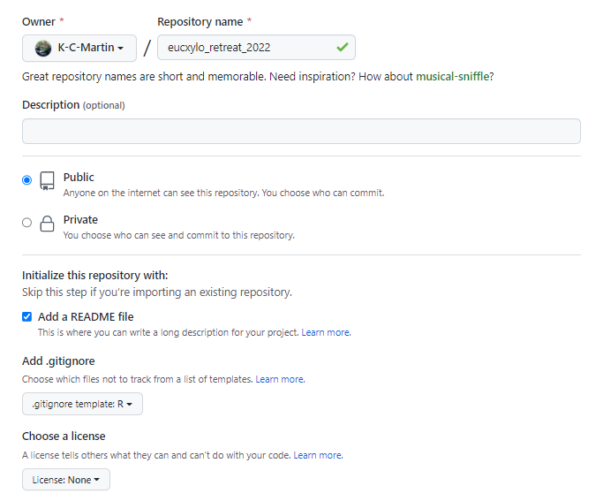
CREATE A REPO ON GITHUB

Slide 23
Creating a Repo on GitHub
Remote Repo
(in GitHub)

Slide 24
Cloning a repo
CLONE
Remote Repo
(in GitHub)
Copy to your own computer
Local Repo (on your computer)

Slide 25
Pulling changes to your computer
PULL
Remote Repo
(in GitHub)
Update the copy on your own computer
Local Repo (on your computer)

Slide 26
Pushing changes back to GitHub
PUSH
Remote Repo
(in GitHub)
Update the online version with your changes
Local Repo (on your computer)

Slide 27
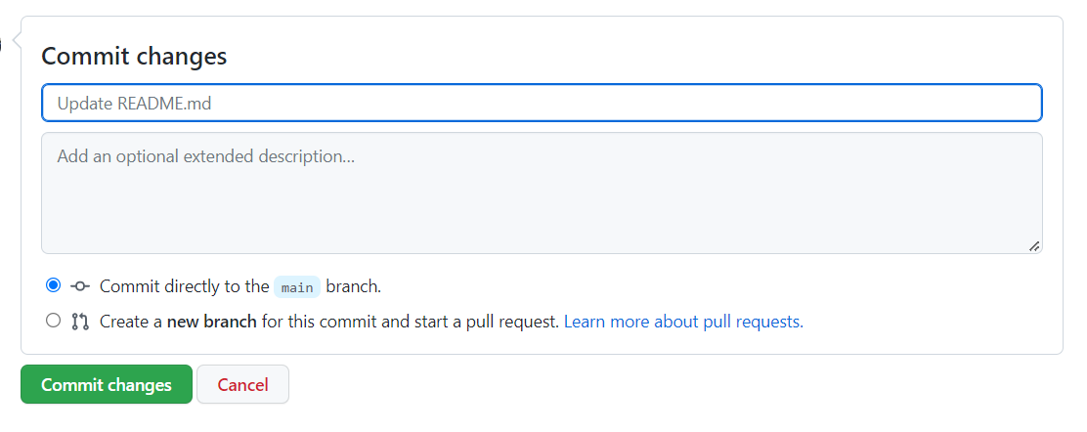
Edit the README in your browser… Commit a change

Slide 28
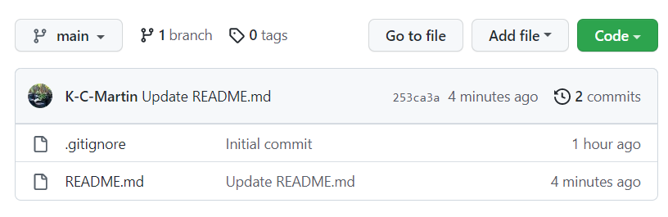
Have a look at your Commit History
Open it, then click on the newest commit to see changes

Slide 29
Commit history - timeline of version changes (with IDs)
INSIDE REPO:
It’s a good idea to write short, informative Commit messages.
Try to be ‘helpful’ to your future self, and your collaborators!
#1
#2

Slide 30
Create branches to test out things…
INSIDE REPO:
main
#1
#2
#3
test-branch
#4

Slide 31
… merge branches into the ‘main branch’ to add changes
INSIDE REPO:
main
#1
#2
#3
#5
test-branch
#4

Slide 32
… and delete the reference to the test branch afterwards
INSIDE REPO:
main
#1
#2
#3
#5
#4

Slide 33
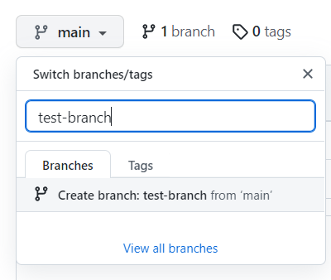
Create a new branch (call it anything you want)
Give the new branch a name
Then create it

Slide 34




EXERCISE: Edit a file in the new branch
In your new branch, edit the README again
Give it a good commit message!
Look at the commit history
Switch back to the main branch - compare the two

Slide 35

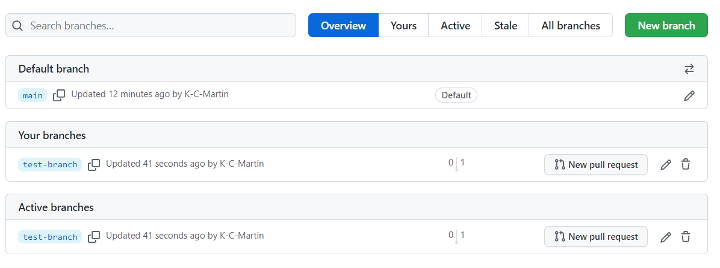
Open a Pull Request (PR), merge the branches
Click to view all branches
PR

Slide 36
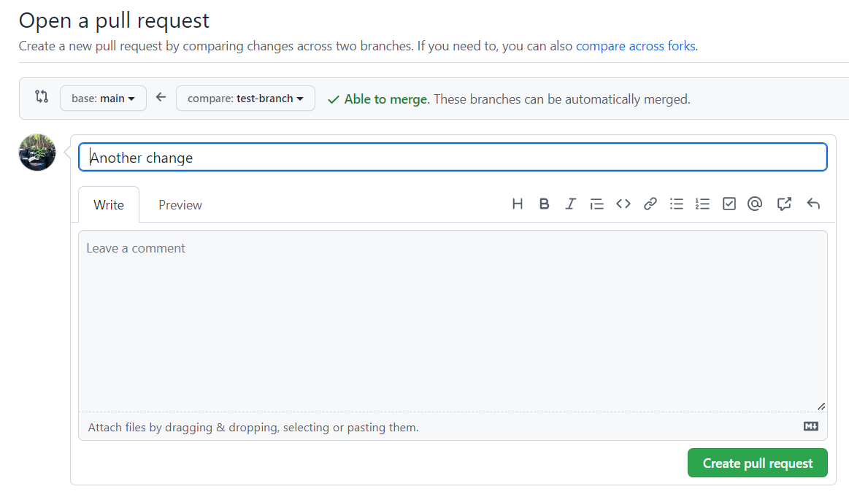

Slide 37
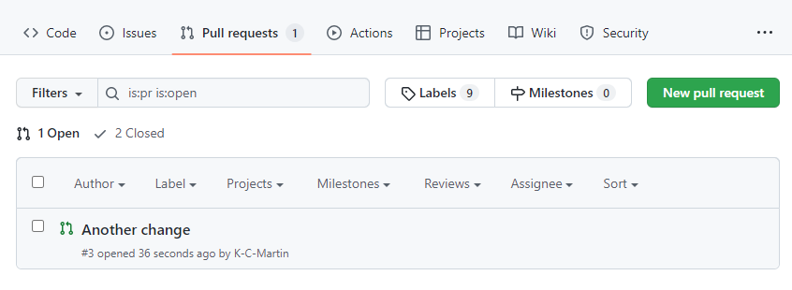
Have a look at the ‘Pull requests’ tab in your repo

Slide 38
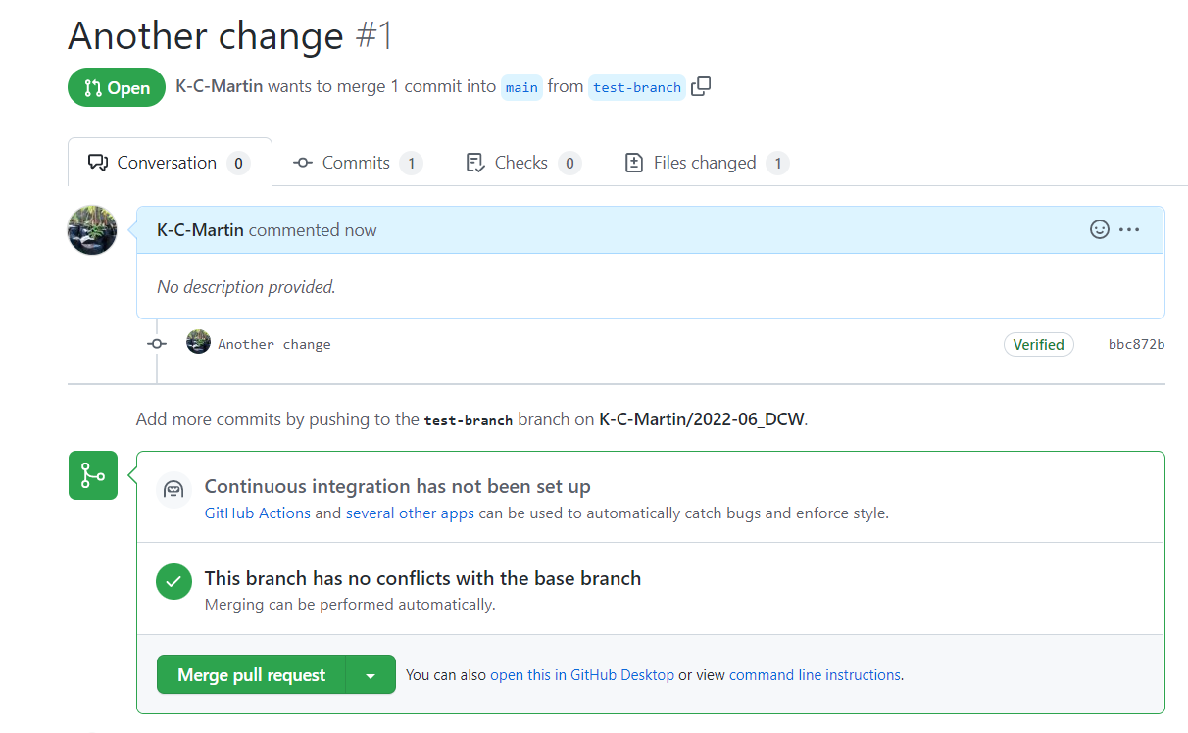
OR ADD A COMMENT BELOW TO ASK FOR MORE CHANGES…

Slide 39
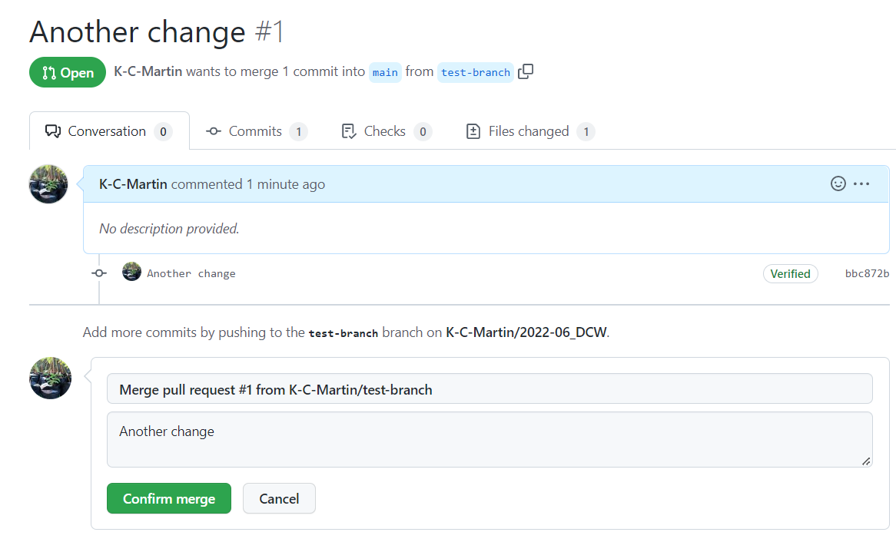

Slide 40
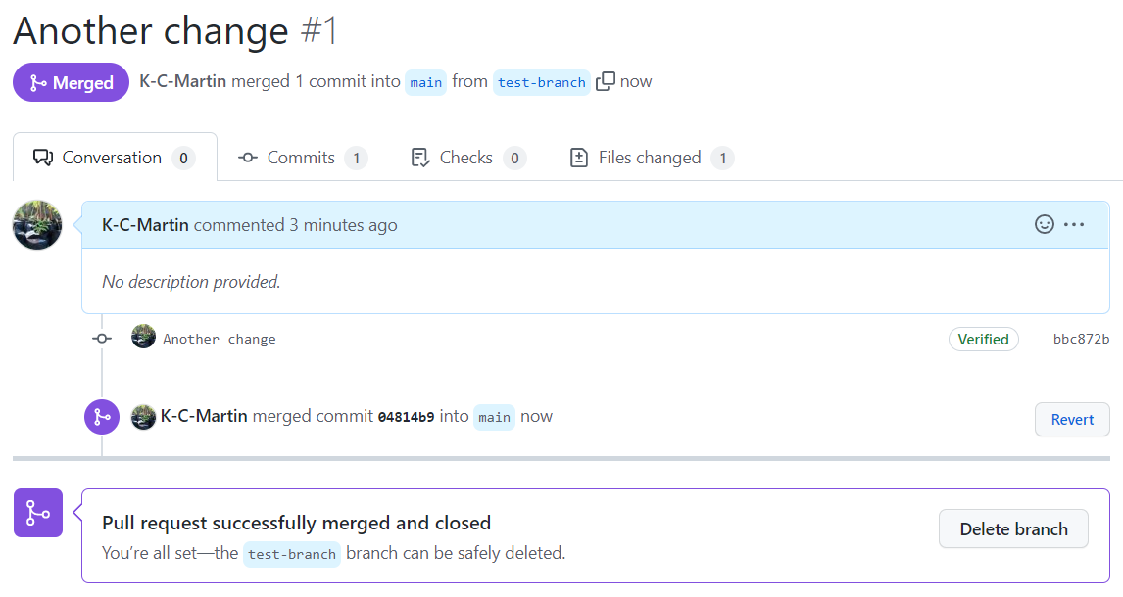

Slide 41
Have a look at your commit history - see the ‘merge’
INSIDE REPO:
main
#1
#2
#3
#5
#4

Slide 42
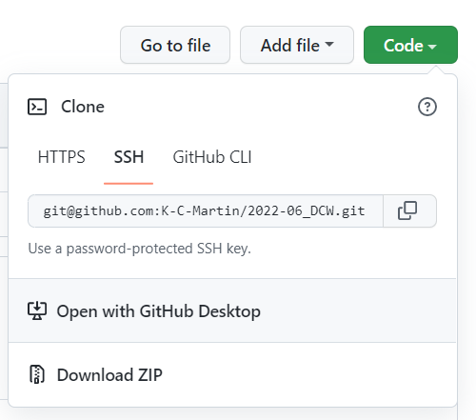
Cloning a repo
CLONE
Remote Repo
(in GitHub)
Copy to your own computer
Local Repo (on your computer)

Slide 43
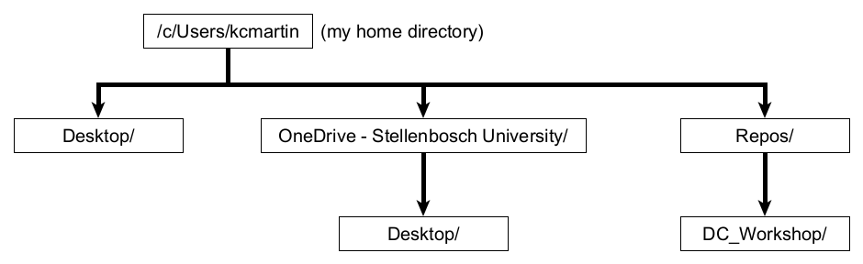
Cloning a repo
Do NOT put your Repos folder in OneDrive!!

Slide 44
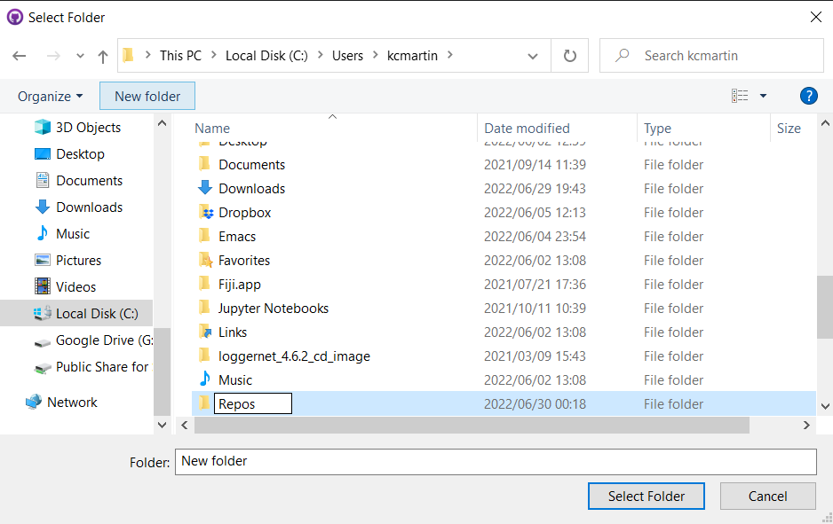
Create a ‘Repos’ folder in your User Directory

Slide 45
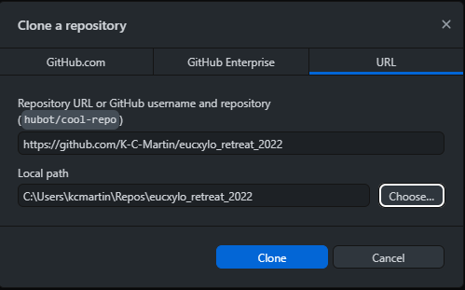
Cloning a repo
Do NOT put your Repos folder in OneDrive!!

Slide 46
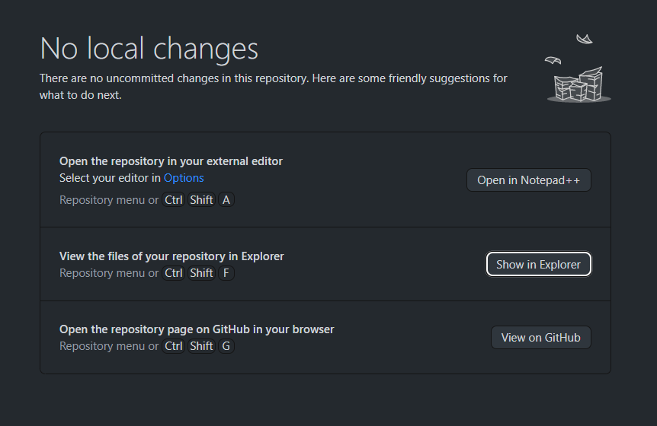
Open the folder containing your Repo

Slide 47
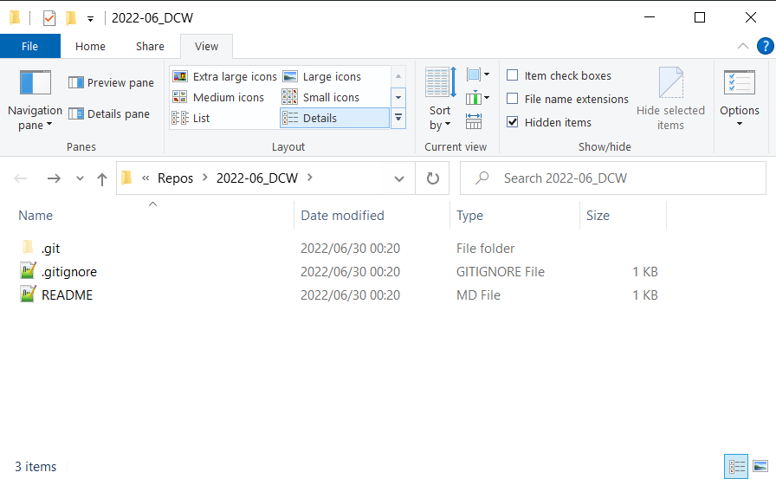
The hidden ‘.git’ folder is your Git Database (all commits)

Slide 48
Cloning a repo
CLONE
Remote Repo
(in GitHub)
Copy to your own computer
Local Repo (on your computer)

Slide 49
Pushing changes back to GitHub
PUSH
Remote Repo
(in GitHub)
Update the online version with your changes
Local Repo (on your computer)

Slide 50
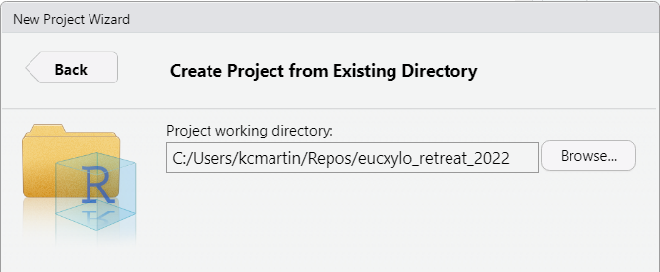
EXERCISE: Create an RStudio Project in the repo
Open RStudio
File > New Project
Create a New Project in an Existing Directory
Pick your new repo folder (look inside the Repos folder in your user directory)

Slide 51
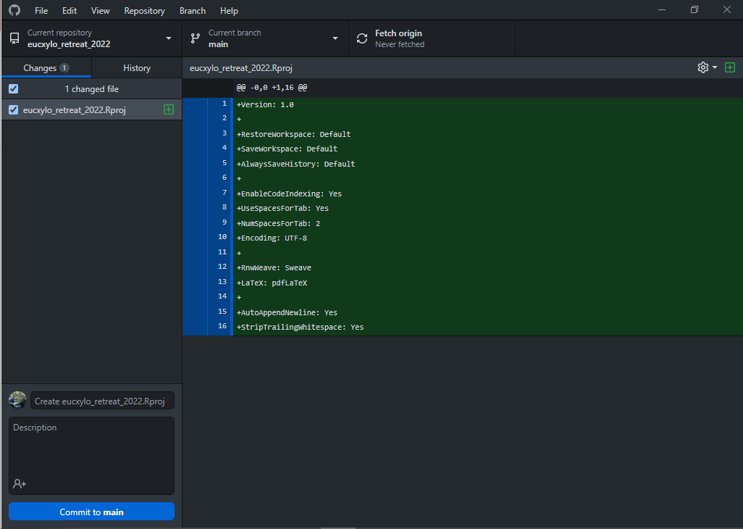
Have a look at GitHub Desktop…
Newly-created ‘R Project’ file
Note: this hasn’t been added to the git ‘database’ yet… but git (GitHub) is ‘aware’ of it.

Slide 52
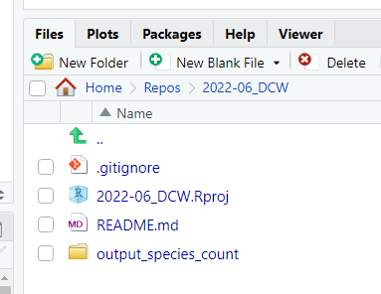
EXERCISE: Create a folder and an R Script file in the repo
Create a New Folder in RStudio - call it: output_species_count
File > New File > R Script
Add some text : # TODO - Cool stuff!
File > Save As … save the script
in the new folder (output_species_count)
as species_counts

Slide 53
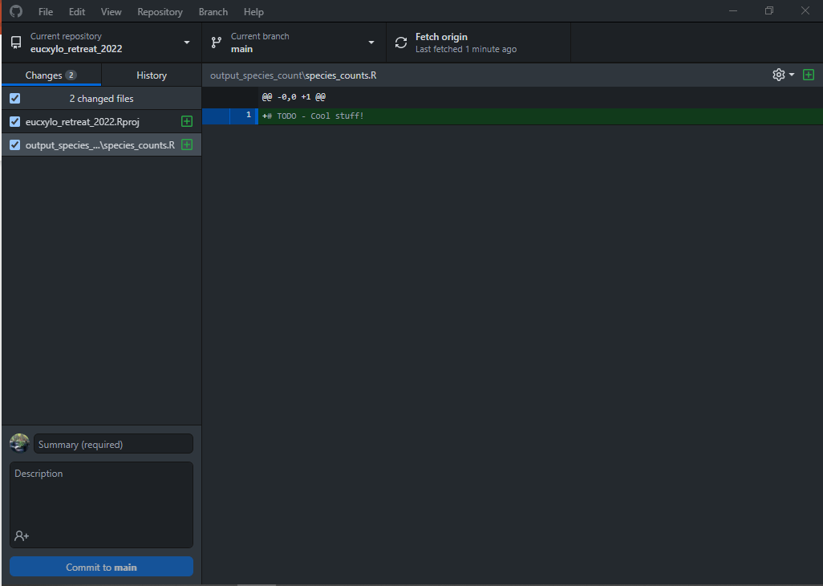
Have a look at GitHub Desktop…
Newly-created ‘R’ file along with previously-created ‘R Project’ file
Note: these haven’t been added to the git ‘database’ yet… but git (GitHub) is ‘aware’ of them.

Slide 54
Basic idea - staging and committing
add
commit
push
Workspace
Staging Area
Local Repo
Remote Repo
(e.g. in GitHub)

Slide 55
Basic idea - staging and committing
add
commit
push
Workspace
Staging Area
Local Repo
Remote Repo
(e.g. in GitHub)

Slide 56
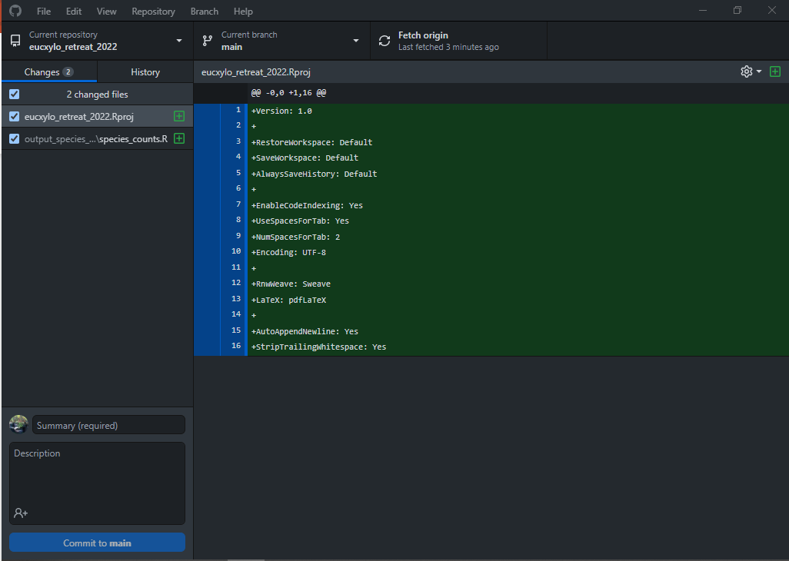
Files that are selected are ‘Staged’ to be Committed

Slide 57
Basic idea - staging and committing
add
commit
push
Workspace
Staging Area
Local Repo
Remote Repo
(e.g. in GitHub)

Slide 58
Basic idea - staging and committing
add
commit
push
Workspace
Staging Area
Local Repo
Remote Repo
(e.g. in GitHub)

Slide 59
After Staging (selecting) changes, Commit changes to .git

Slide 60
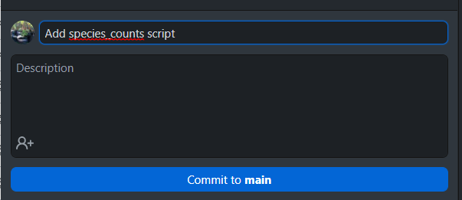
Write an informative ‘Commit Message’ and then commit

Slide 61
Basic idea - staging and committing
add
commit
push
Workspace
Staging Area
Local Repo
Remote Repo
(e.g. in GitHub)

Slide 62
Basic idea - staging and committing
add
commit
push
Workspace
Staging Area
Local Repo
Remote Repo
(e.g. in GitHub)

Slide 63
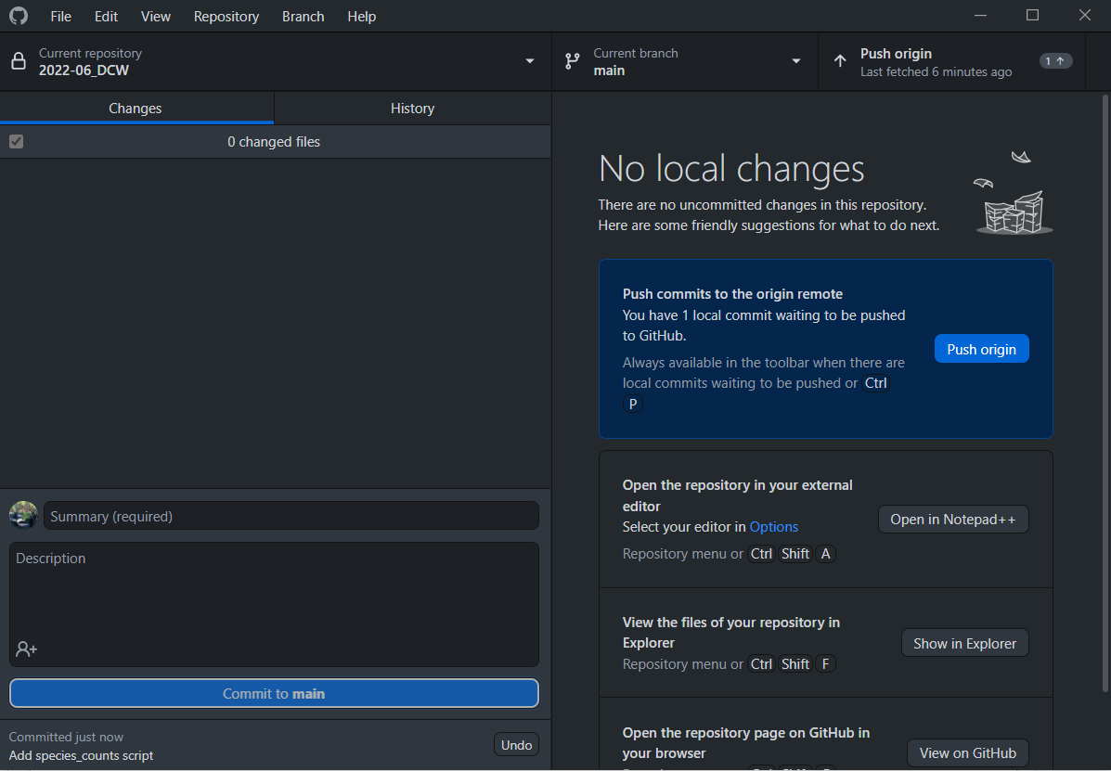
To send your local changes to the cloud, PUSH!

Slide 64
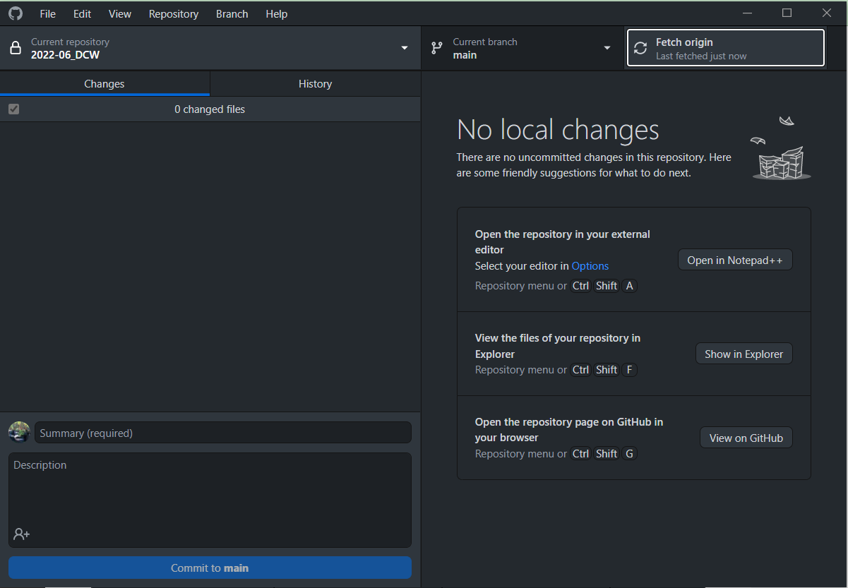
‘Fetch’ checks GitHub (‘origin’ repo) for changes…

Slide 65
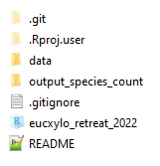
EXERCISE: Add data to Repo (okay for small examples…)
Take the provided ‘data’ folder and copy it into your repo folder
Commit and Push the changes to your repo using GitHub Desktop
Inspect the data in GitHub (website)

Slide 66
EXERCISE: Commit changes to R Script
In RStudio, paste the provided text into the species_counts.R file, and save
Select all (Ctrl-A) and run the script (Ctrl-Enter)
Commit and Push the changes to your repo using GitHub Desktop
Navigate inside the ‘output_species_count’ folder in GitHub (website), and inspect the png and csv files

Slide 67
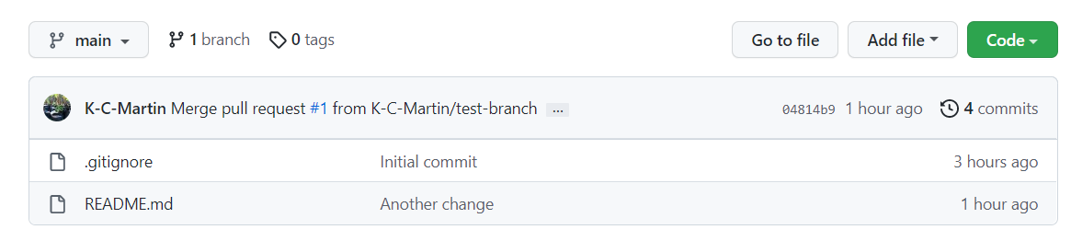
Look at the commit history in GitHub Desktop
You can also look at the ‘History’ tab in GitHub Desktop for the commits in the local Repo
You can inspect changes in each commit - note the value of ‘informative commit messages’!

Slide 68
EXERCISE: What happens with conflicting edits?
On GitHub (website) add some text to the README - commit the change with the message ‘online edit’
On your computer, open the README in your local repo and add some different text - commit the change with the message ‘local edit’
In GitHub Desktop, try to Push the change… you will be asked to Fetch online changes first… Fetch, and then try to Pull again

Slide 69
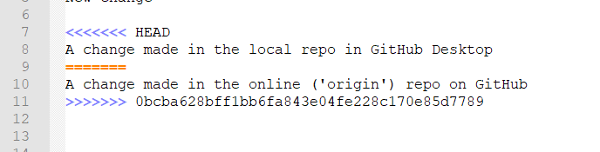
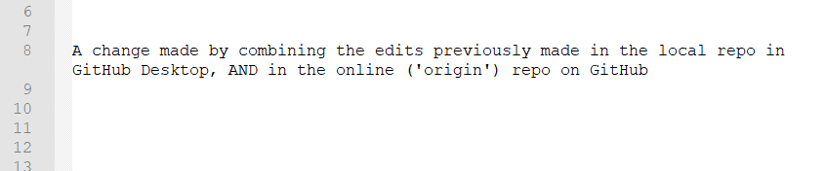
Resolving merge conflicts (remove the <<< >>> lines too!)
Save the README file after you’ve resolved the conflict, and ‘Continue merge’
… then Push

Slide 70
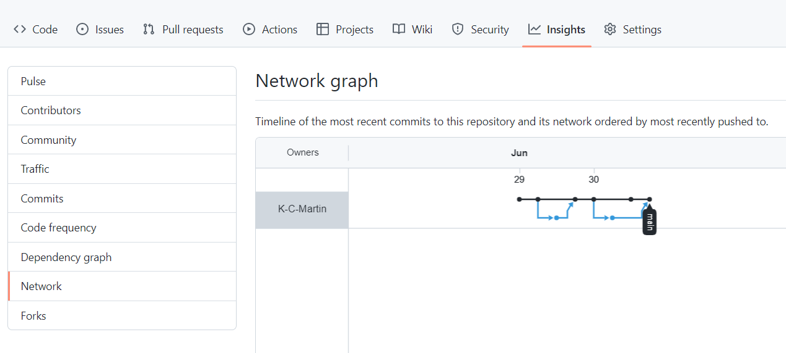
Something cool in GitHub… Insights > Network
TRY CLICKING ON THE ‘COMMIT’ DOTS

Slide 71
EXERCISE: Update README with GitHub Markdown
In GitHub (website), paste the provided text into the README
Look at the ‘Preview’ tab before you Commit (Google ‘GitHub Markdown’ later!)
Commit the changes
Click on the plot, look for the quickest way to the folder that contains its script

Slide 72
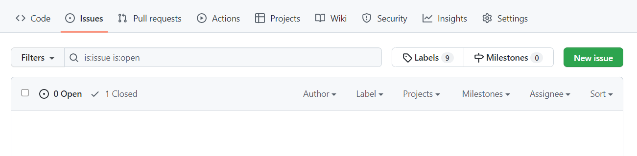
‘Issues’ are a way to track problems / tasks / ideas…
You can have long conversations with collaborators…

Slide 73
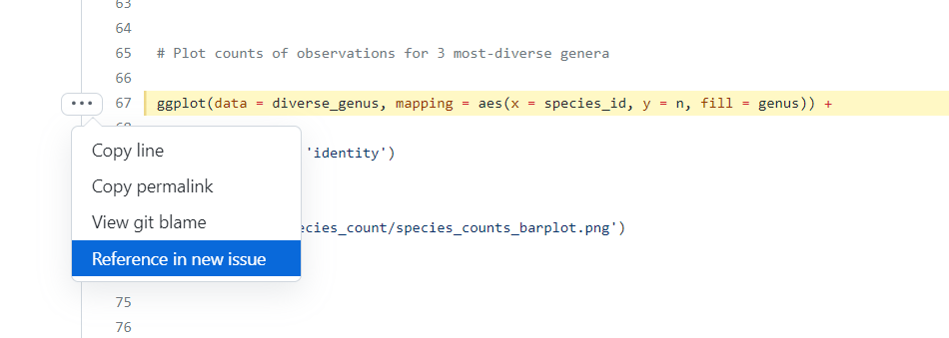
You can ‘Open an Issue’ directly from a line of code…

Slide 74
EXERCISE:
Paste the link to your repo in the Teams Chat
Visit the link to the repo that was posted right after you posted yours
Navigate to the R Script in the subfolder (you can click on the plot in the README, and navigate from there)
Open an issue on the line of code that creates the plot - suggest they make it grey-scale (not all journals accept colour figures… or it might cost more!!)

Slide 75
EXERCISE:
Once you’ve had some feedback (via an Issue)... try to edit your code to respond to the suggestion ()
Once your code works the way you want it to (and you’ve saved it), Commit and Push, and have a look at GitHub
tip… try adding + scale_fill_grey() after geom_bar(stat = ‘identity’) (line 77)…
pro-tip… try adding ‘Closes #x’ in the commit Description box… where ‘x’ is the issue number

Slide 76
EXERCISE: .gitignore makes Git Ignore things…
Create a folder called ‘notes’ in your repo, and put something inside it (an empty txt file)
Look at GitHub Desktop - you should see the new file in the data folder
Open the .gitignore file and insert this at the top, then save: notes/
Look at GitHub Desktop again…

Slide 77
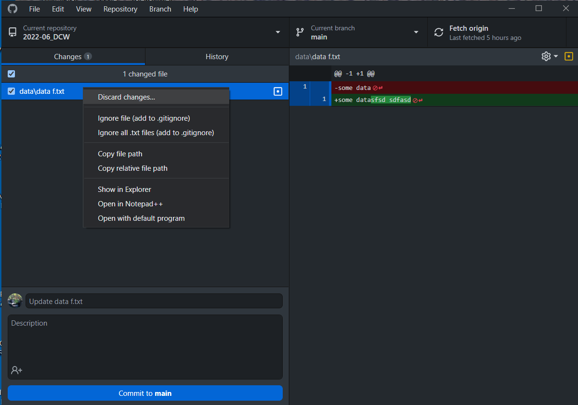
You can ‘discard changes’ instead of committing
Right click on the staged files you want to discard changes in.
‘Discard changes’
The file will go back to the way it was when you last committed it.

Slide 78
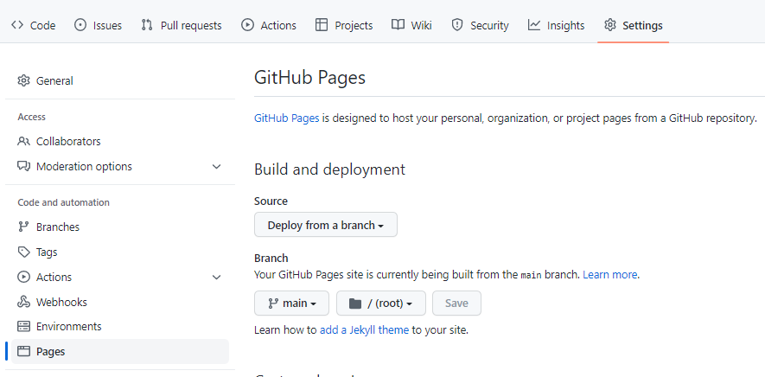
Turning your repo into a website
CHECK BACK LATER…

Slide 79
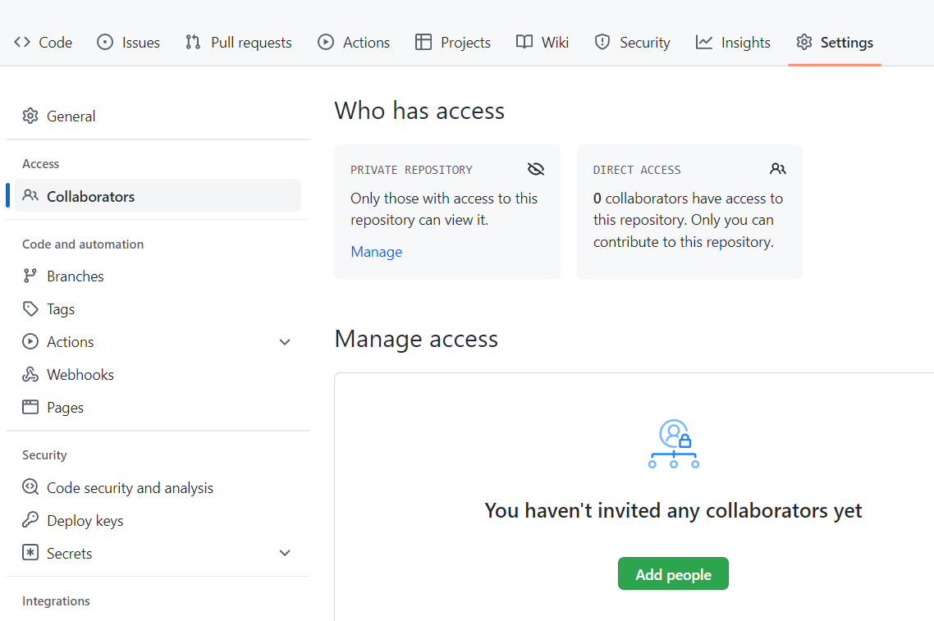
Adding collaborators (giving edit access to your repo)

Slide 80
Cloning a repo
CLONE
Remote Repo
(in GitHub)
Copy to your own computer
Local Repo (on your computer)

Slide 81
Pulling changes to your computer
PULL
Remote Repo
(in GitHub)
Update the copy on your own computer
Local Repo (on your computer)

Slide 82
Pushing changes back to GitHub
PUSH
Remote Repo
(in GitHub)
Update the online version with your changes
Local Repo (on your computer)

Slide 83
Cloning vs forking
FORK
Copy to your own account
CLONE
Remote Repo
(in GitHub)
Remote Repo
(in GitHub)
belonging to someone else (public, but you haven’t got permission to edit it)
Copy to your own computer
Local Repo (on your computer)

Slide 84
Suggesting changes with a Pull Request (PR)
PULL REQUEST
Suggest changes to the original owner
PUSH
Remote Repo
(in GitHub)
Update the online version with your changes
Remote Repo
(in GitHub)
belonging to someone else (public, but you haven’t got permission to edit it)
Local Repo (on your computer)

